Slide 1
Stiles Jarrett RPL Summer 2023 Week 3

Slide 2
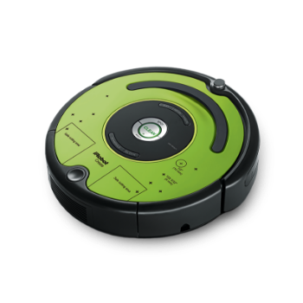
Current Progress:
Current Project:
Our current project is to create an autonomous trash can that will follow a set course around the lab and rechart it’s navigation route in the event of obstacles.
As of this week we have created a program to ensure that when the Roomba we are using as a place holder detects an object it diverts paths before collision
Next Steps:
Next week we will be switching to the TurtleBot and using it’s IR Sensors to make a map of the room which we will then use to make an accurate route for the robot to travel when in use.

